Slide 1
Design Patterns

Slide 2
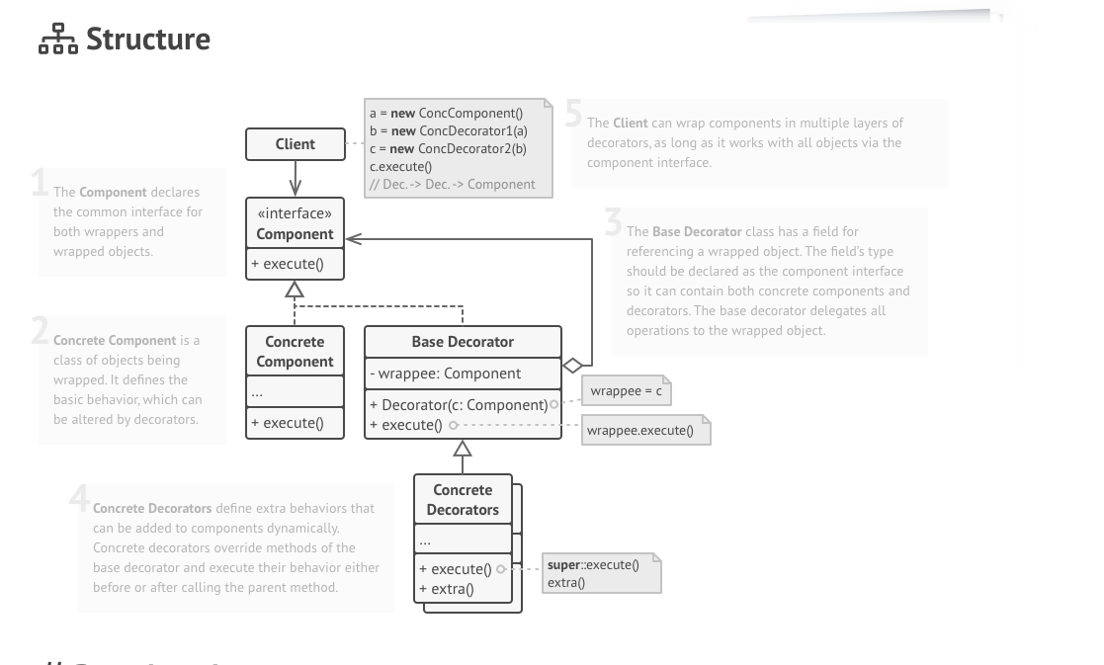
Decorator

Slide 3
Problem Statement
We have a Apartment complex from Prestige Builders.
Apartment requires Interiors.
Apartment complex with 10000 flats.
All are 2 BHK.
Customers can buy apartment only with Interiors.
Cost of every apartment is = 40 lakhs.
Interiors is mandatory for 5lakhs min.
Customer can choose to go for may be till 50 lakhs or more interiors.

Slide 4
Software solution for interior designing.
Interior designing
Interior estimates
Billing

Slide 5
Estimate Design
2BHK Flat
2BHK Flat with Bedroon
2BHK Flat with Kitchen interiors
2BHK Flat with Hall interiors
2BHK with Kitchen and hall interious
Std Kitchen – 5L
Italian – 2L+
Island – 3L+
Std Hall – 3L
Swing – 1L+
TV and Home theater – 2L+
Bedroom – 3L
TV station – 1L+
False cieling – 1L+

Slide 6
Estimate module
Report with total cost
Main product
+
Selected products
Report with Diagram

Slide 7
If Flat cannot modified then adding new types of decorator is a problem.
Enhancements are not possible without changes to base class.
2BHK Flat + std Kitchen+ Island + kids Bedroom
2BHK Flat + std Kitchen + Island
2BHKFlat
ArrayList<Interiors> list-interiors
int totalPrice()
void addInteriors(Interior interior)
2BHK Flat + std Kitchen
2BHK Flat
Exteriors
Painting
Gardening
Interiors
int price()
Boolean checkFeasibility(Flat)
PradeepFlat
BhadriFlat
Std kitchen
Kitchin island
Kids bedroom
Kitchen Italin top
Std kitchen
Island island
…..
…..

Slide 8
Exteriors
<Flat>
int price()
Association
Painting
Gardening
Composition
Aggregation
2BHKFlat
int price()
Island + Std kitchen + PradeepFlat
Std kitchen PradeepFlat
Interiors
- Flat flat
int price()
Boolean checkFeasibility(Flat)
decorate(Flat)
PradeepFlat
BhadriFlat
Std kitchen
kitchen island
Kids bedroom
Kitchen italian top
Std kitchen
Island island
…..
…..

Slide 9
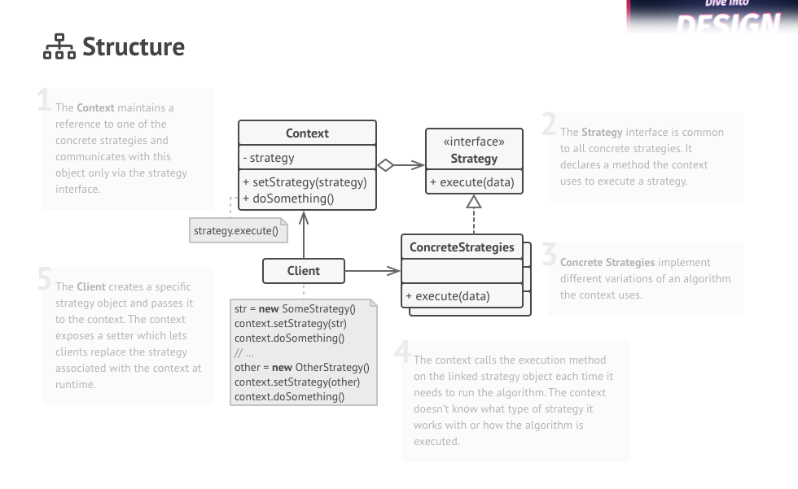
Stratergy

Slide 10
Problem Statement
Find a house for rent.
Input: area and rent amount
Output: Rental Agreement
Sources to find rental houses
Internet Nobroker(without brokerage)
Internet CommonFloor(with Brokerage)
Human Broker
On Bike Manual search
E.G. Rajat, Near ITPL, 20000
Jawahar Near ITPL, 100000

Slide 11
Client
HouseFinder
+findHouse(amount, location)
+selectChannel(Channel stratergy)
<Channel>
House Search(amount, location)
CriteriaAnalyser
+Channel Analyze(Criteria criteria)
Nobroker
Commonfloor
HumanBroker
OnBikeSelf
NoBroker interface

